Slide 1
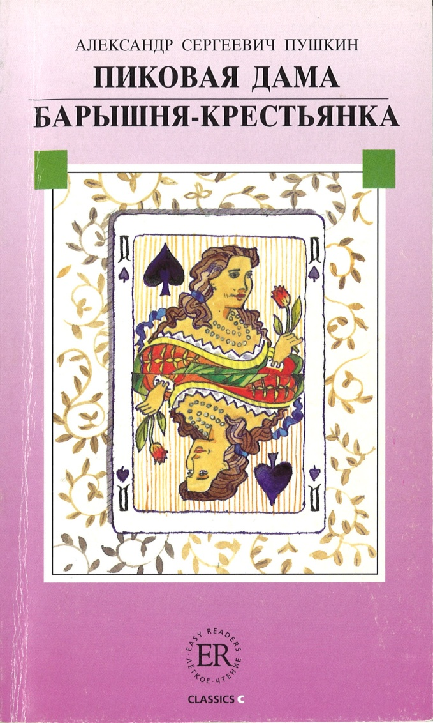
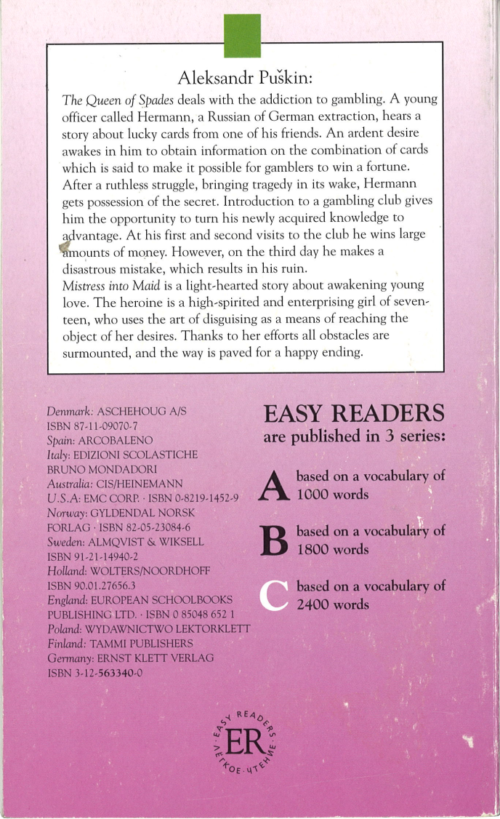
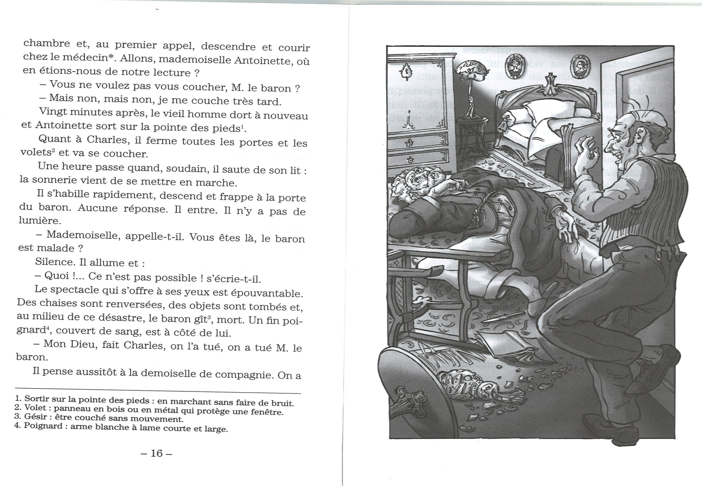
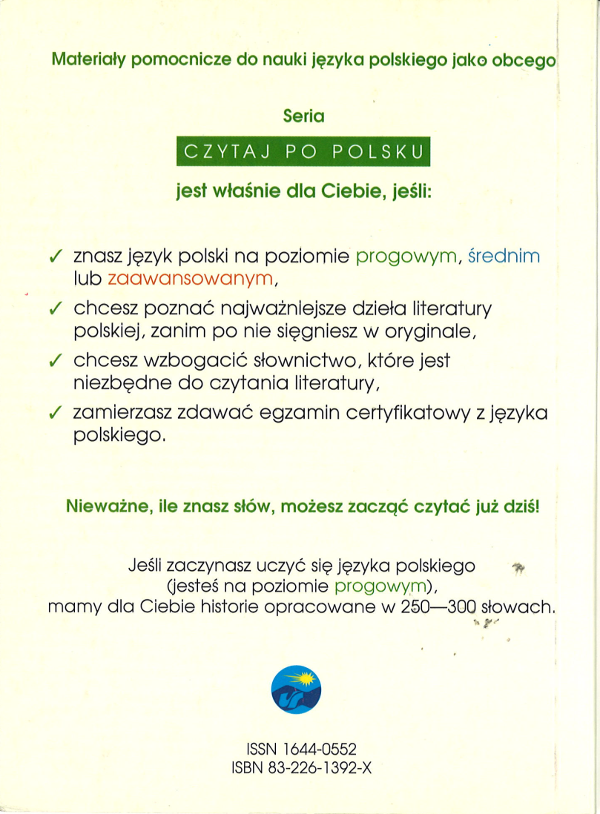
Creating resources for the development of reading skills in Polish at ab initio level
Texts in SL teaching
Teksty prymarne (original texts) to teksty autentyczne, nie są przeznaczone dla celów dydaktycznych;
teksty adaptowane (simplified/adapted texts) są przystosowane przez uproszczenie i zredukowanie leksyki oraz trudniejszych struktur składniowych i gramatycznych;
teksty sekundarne (prepared texts) są preparowane, opracowywane specjalnie dla celów dydaktycznych; służą do zilustrowania zjawisk gramatycznych, zaprezentowania nowych jednostek leksykalnych lub przekazania pewnych wiadomości realioznawczych. (A. Kozłowski, 1991: 14-15)
Simplified texts in SL teaching
adaptacja sensu stricto:
adaptacja eliminująca (simplification by elimination),
adaptacja modyfikująca (simplification by modification);
adaptacja sensu largo:
adaptacja selektywna (selective simplification),
adaptacja komplementarna (complimentary simplification).
(A. Kozłowski, 1991:31-32)
Illustrations and glossing may facilitate reading experience.
In what ways can literary texts be adapted for students at beginners level?
Language of graded readers
Based on wordlists and structure lists, accessible for ESL (I.P.S.Nation, 2009) and in need of an update in Polish (H. Zgółkowa, 1992; A. Seretny, 2011).
Word count – Edinburgh Project on Extensive Reading (EPER)
Source: D.R.Hill, 1997:67
Why graded readers for learners of Polish?
to encourage students to read other texts (apart from textbooks),
to support development of interest in Polish language and culture,
to promote literature/to introduce students to literature studies.
An example of Russian graded reader, based on the literary classic.
Which literary texts could be used for adaptation?
Extensive reading
Well-balanced language course divides time equally between four strands:
meaning-focused input,
meaning-focused output,
language-focused learning,
fluency development.
(I.P.S. Nation, 2009:1)
Extensive reading fits into the meaning-focused input and fluency development strands of a course. (I.P.S. Nation, 2009:49)
Graded readers
Extensive reading may be based on graded readers.
Graded readers are extended texts, mostly fiction, written in language reduced in terms of structures and vocabulary.(D.R. Hill, 1997:57)
Polish graded reader? In what ways does the fall of communism influence Polish discussion of the literary canon?
Marta Becquet, MPhil Student in Slavonics
Supervisors: Dr Elwira Grossman & Dr John Bates
m.becquet.1@research.gla.ac.uk
University of Glasgow, charity number SC004401

